Slide 1
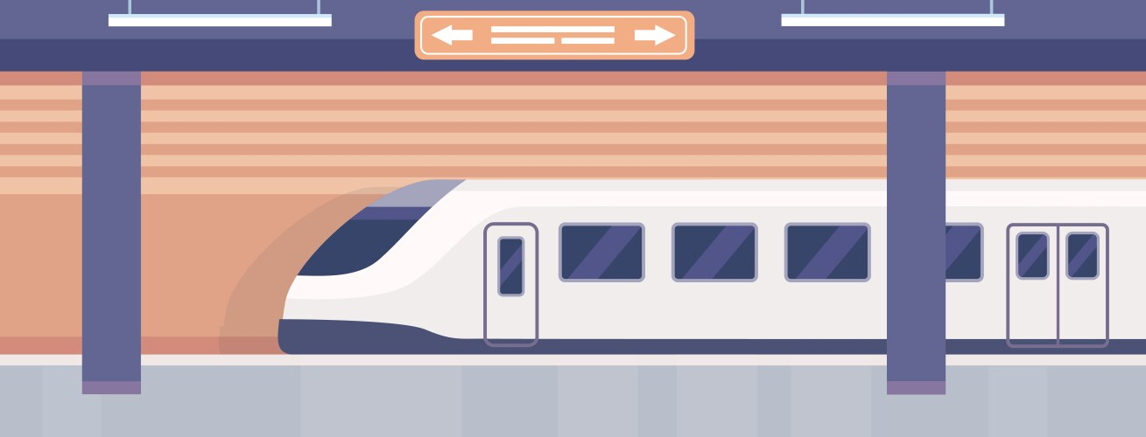
Team IC25057 - Beyond the Commute:
Investigating DC WMATA Ridership Trends
and Patterns
Alexa Chu, Sophia Narido, Amira Tlemsani

Slide 2
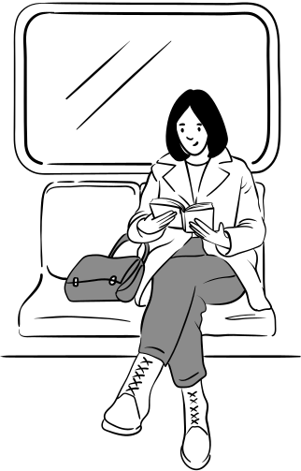


Research Questions
Main Research Question:
How do business and retail hubs impact average daily entries for metro ridership?
How do top stations differentiate based on weekdays and weekends?
Which jurisdictions in the DMV have the most average daily entries?

Slide 3
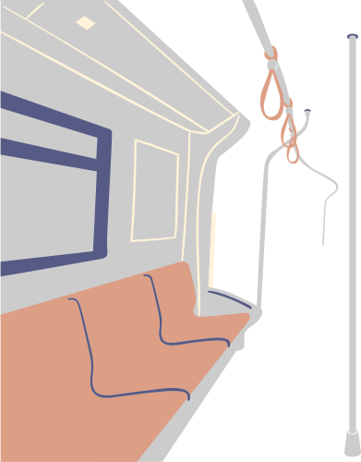
Approaches
Python:
Pandas
Matplotlib
Beautiful Soup
ArcGIS
Used Open Source Data
Mapped high ridership stations.
Mapped business and retail hubs
Research:
Transit authority data
News & policy analysis

Slide 4

Visualizations

Slide 5
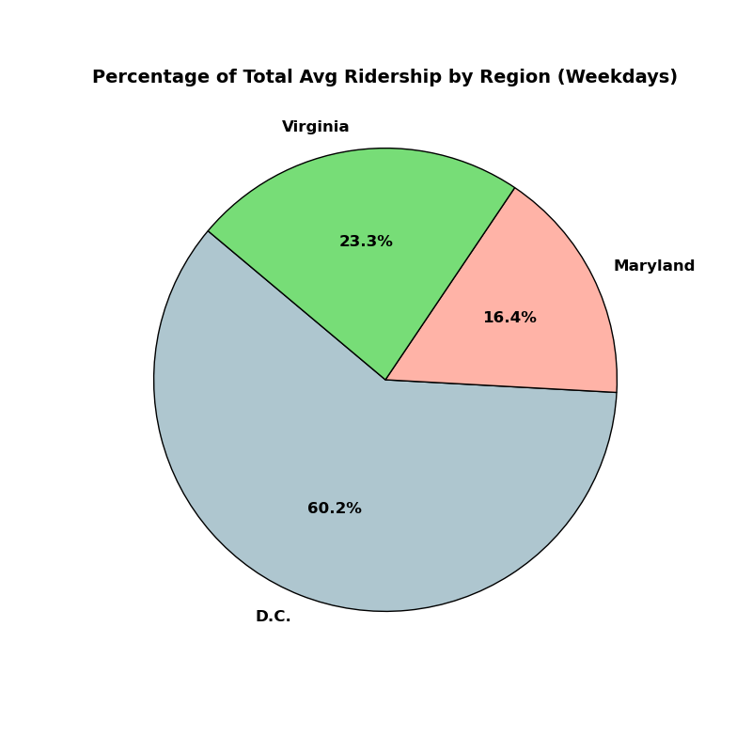
Percentage of Total Avgerage Ridership By Region (Weekdays)

Slide 6

Percentage of Total Average Ridership By Region (Weekends)

Slide 7

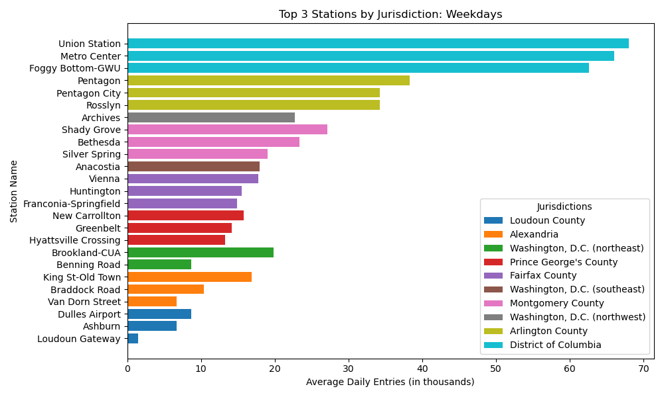

Slide 8

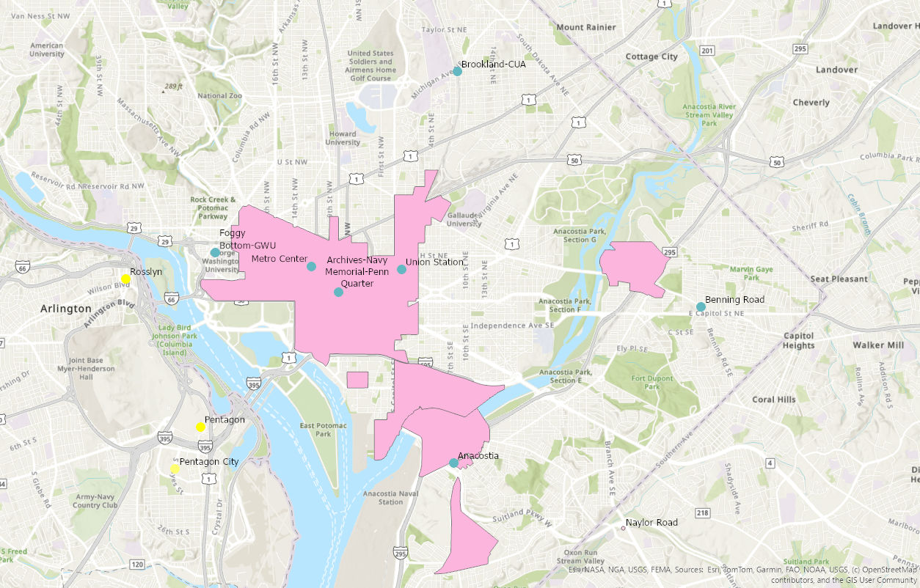


Map
(Weekday)
Legend:
= Highest ridership in DC on Weekdays
= Highest ridership in Arlington on Weekdays
Pink polygons indicate where businesses/companies reside in DC.

Slide 9
Metro Line Correlations Weekdays
Green Line: Archives (DC),Anacostia (DC), Greenbelt(MD), Hyattsville Crossing(MD)
Red Line: Union Station(DC), Metro Center(DC), Shady Grove(MD), Bethesda(MD), Silver Spring(MD), Brookland-CUA(DC)
Blue Line: Metro Center(DC), Foggy Bottom-GWU(DC), Pentagon(Virginia), Pentagon City(Virginia), Rosslyn(VA), Franconia-Springfield(VA), Benning RD(DC),King St-Old Town(VA), Braddock RD(VA), Van Dorn Street(VA)
Silver Line: Metro Center (DC), Foggy Bottom-GWU(DC), Rosslyn(VA), Benning RD(DC), Dulles Airport(VA), Ashburn(VA), Loudoun Gateway(VA)
Orange Line: Metro Center (DC), Foggy Bottom- GWU(DC), Rosslyn(VA), Vienna(VA), New Carrollton(MD)
Yellow Line: Pentagon (VA), Pentagon City(VA), Huntington(VA), King St-Old Town(VA), Braddock RD(VA), Archives(DC)

Slide 10
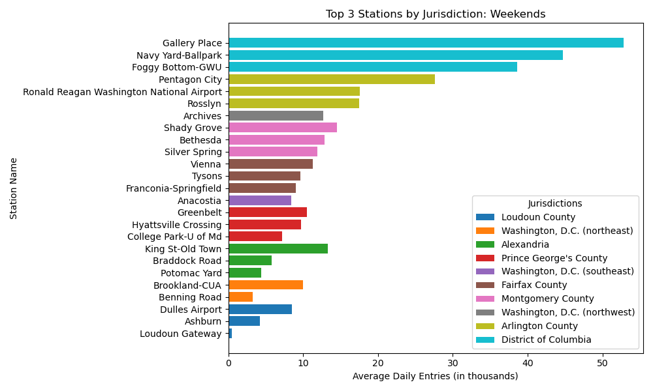
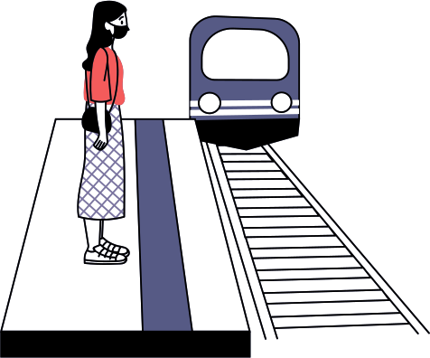

Slide 11

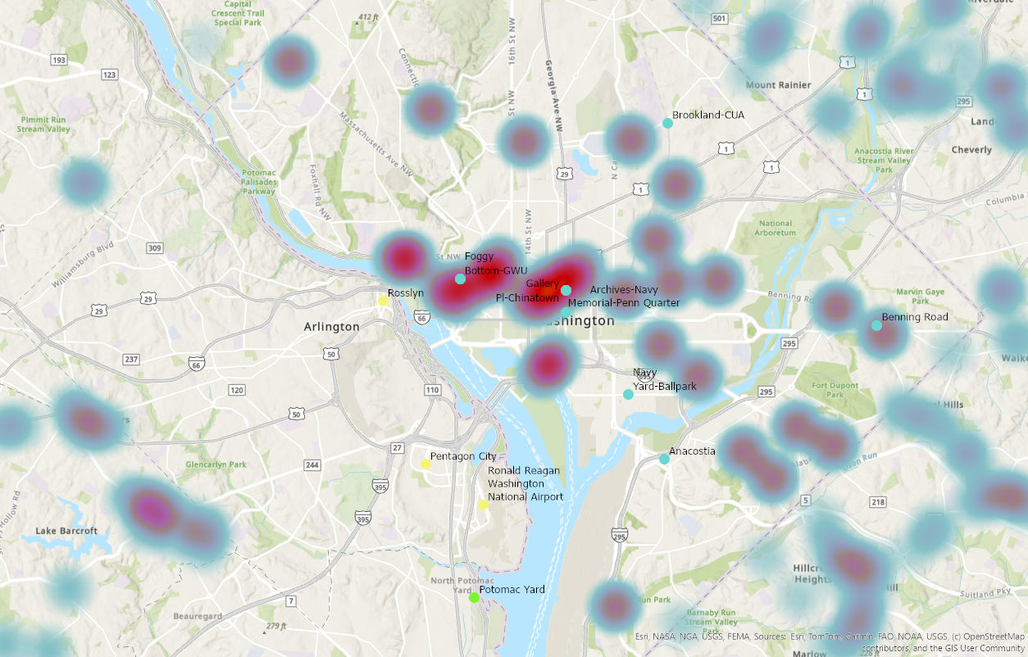

Heat Maps (Weekend)
Legend:
= Highest ridership in DC on Weekends
= Highest ridership in Arlington on Weekends
Red hotspots indicate shopping center locations in DC

Slide 12
Metro Line Correlations of Weekends
Green Line: Gallery Place(DC), Navy Yard-Ballpark(DC), Anacostia(DC), Greenbelt(MD), Hyattsville Crossing(MD), College Park-U of MD(MD)
Red Line: Gallery Place(DC), Archives(DC), Shady Grove(MD), Bethesda(MD),Silver Spring(MD), Brookland-CUA(DC)
Blue Line: Foggy Bottom-GWU(DC), Pentagon City(VA),Ronald Reagan National Airport(VA), Rosslyn(VA), Franconia- Springfield(VA), King St-Old Town(VA), Braddock RD(VA), Benning RD(DC)
Silver Line: Foggy Bottom-GWU(DC), Tysons(VA) ,Benning RD(DC), Dulles Airport(VA), Ashburn(VA), Loudoun Gate(VA)
Orange Line: Foggy Bottom-GWU(DC), Rosslyn(VA), Vienna(VA)
Yellow Line: Gallery Place(DC), Pentagon City(VA), Ronald Reagan National Airport(VA), Archives(DC), King St-Old Town(VA), Braddock RD(VA), Potomac Yard(VA)

Slide 13


Differences (Weekend vs Weekday)
Jun 15
2024
Dec 04
2024
Navy Yard-Ballpark
Events that occurred:
Washington Nationals home game against the Miami Marlins @ 1:35 pm
Episcopal Night @ 4:00 pm - 7:00 pm
2024 Taiwan Day @ 4:00 - 7:00 pm
Average Daily Entries: 7.4 K
Highest entry compared to other dates
Example: June 05, 2024 (a weekday) had 4.1 K daily entries
Union Station
Peak PM hours (3:00 pm - 7:00 pm) are when employees go home
Commuters are likely to use metro station
Average Daily Entries: 6.7 K
Highest compared to other dates
Example: June 15, 2024 (a weekend) had 2.5 K daily entries

Slide 14
Future Works/Applications
Our research provides a valuable foundation for companies, bussinsess, or retail stores seeking ideal locations for expansion, suggesting that the best locations would be near the high-traffic stations we identified.
In the future, we could further analyze which specific times of day experience the highest average daily entries to gain deeper insights.

Slide 15
Sources
https://www.crummy.com/software/BeautifulSoup/bs4/doc/
https://gisdata.pgplanning.org/opendata/search.asp?s=Shop
https://edow.org/event/episcopal-night-at-the-nationals-stadium/
https://allevents.in/washington/2024-taiwan-day-washington-dc-nationals-park/200026333532700#google_vignette

Slide 16

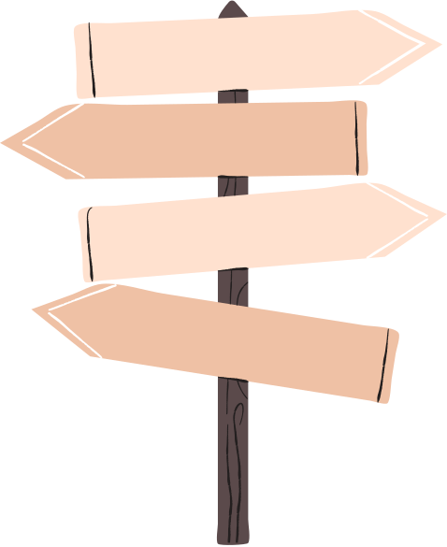
QUESTIONS?

